Slide 1
Nitrosamine impurities analysis using Thermo Scientific™ Orbitrap Exploris™ 120 MS
Hao Yang, Ph.D.
Sr. Application Scientist
Biopharma and Pharma Vertical Marketing

Slide 2
Application: Nitrosamine impurities analysis
Liquid chromatography high resolution mass spectrometry (LC-HRMS) method for NAs detection and quantitation
Nitrosamines (NAs) in APIs and drug products
  Classified as genotoxic impurities, proven as probable human carcinogen
  Detected elevated levels of NDMA and other impurities in several drug products, announced several recalls
  US FDA published validated GC/LC-MS/MS and GC/LC-HRAM methods, and interim acceptable limits for several NAs
  US FDA recently released guidance for industry to 1) conduct risk assessments on approved or marketed drugs and pending applications, and 2) implement control strategy to reduce and prevent formation of NAs in all API and drug products
Goals
  1 single LC-HRMS method for detection and quantitation of 9 NAs
  High selectivity and sensitivity
  Robustness and reproducibility
  Compliant software for data collection and processing
Notes:
Nitrite are common impurities in excipient (drug formulations) at ppm level

Slide 3
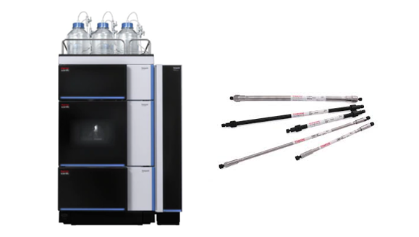
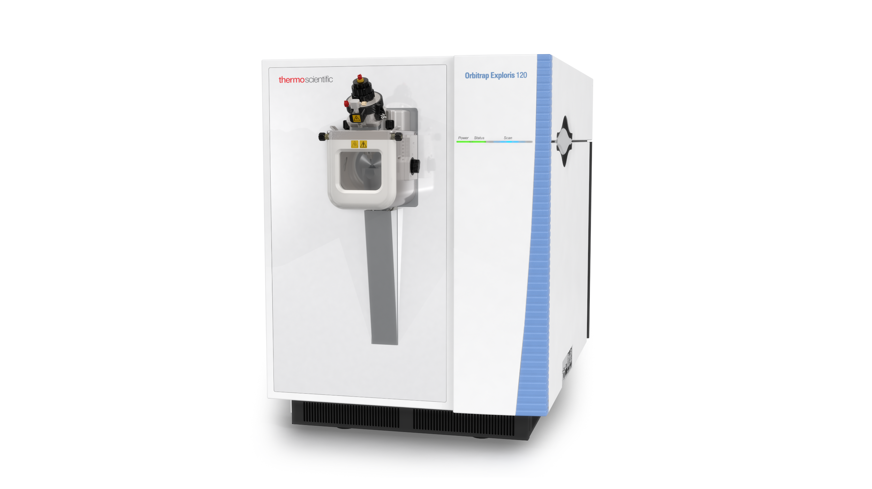

Application: Nitrosamine impurities analysis
Thermo Scientific™ VanquishTM LC and Acclaim Polar Advantage II column, 2.1 x 100mm, 2.2µm
  Excellent retention time and injection reproducibility
  Good peak shape for target NAs
  No carryover for target NAs, except NDBA
Thermo Scientific™ Orbitrap ExplorisTM 120 MS
  Max 120K resolution at m/z 200
  Sub ppm mass accuracy with EASY-IC
  LLOQ ≤ 0.017 ppm for target NAs, in APCI mode for both neat and excipient standards
Thermo Scientific™ Chromeleon™ CDS 7.2.10
  Single platform for MS and chromatography
  Fully integrated with instrument control, data collection, processing and reporting
  21 CFR Part 11 compliant ready with full instrument and data audit trail

Slide 4
Application: Nitrosamine impurities analysis
Robust and reproducible injections
Vanquish LC and Acclaim Polar Advantage II column, 2.1 x 100mm, 2.2µm
  Excellent retention time and injection reproducibility
  Good peak shape across all NAs
  No carryover for target NAs, except NDBA
N = 50, Neat, APCI
Average RT: 0.87 min
RT reproducibility: 0.69%
Average Peak area: 11700
Peak area reproducibility: 2.1%

Slide 5
Application: Nitrosamine impurities analysis
Good separation with minimal carryover for excipient standards
~0.2%
Vanquish LC and Acclaim Polar Advantage II column, 2.1 x 100mm, 2.2µm
  Excellent retention time and injection reproducibility
  Good peak shape across all NAs
  Minimum carryover for target NAs, except NDBA
Carryover, Excipient, APCI
XIC of NAs at 50ng/ml, Excipient, APCI

Slide 6
Application: Nitrosamine impurities analysis
High sensitivity, could achieve LLOQ ≤ 0.017 ppm for target NAs in both neat and excipient matrix
 | Matrix | LOD (ng/ml) | LLOQ (ng/ml) | PPM* | Linearity
NDMA | Neat | 0.2 | 0.2 | 0.0068 | 0.2 – 50
 | Excipient | 0.2 | 0.2 | 0.0068 | 0.2 – 50
NMEA | Neat | 0.2 | 0.2 | 0.0068 | 0.2 – 50
 | Excipient | 0.2 | 0.2 | 0.0068 | 0.2 – 50
NPYR | Neat | 0.1 | 0.2 | 0.0068 | 0.2 – 50
 | Excipient | 0.2 | 0.2 | 0.0068 | 0.2 – 50
NDEA | Neat | 0.1 | 0.1 | 0.0034 | 0.1 – 50
 | Excipient | 0.1 | 0.1 | 0.0034 | 0.1 – 50
NPIP | Neat | 0.1 | 0.1 | 0.0034 | 0.1 – 50
 | Excipient | 0.2 | 0.2 | 0.0034 | 0.1 – 50
NEIPA | Neat | 0.5 | 0.5 | 0.017 | 0.5 – 50
 | Excipient | 0.5 | 0.5 | 0.017 | 0.5 – 50
NDIPA | Neat | 0.1 | 0.1 | 0.0034 | 0.1 – 50
 | Excipient | 0.1 | 0.1 | 0.0034 | 0.1 – 50
NDPA | Neat | 0.1 | 0.1 | 0.0034 | 0.1 – 50
 | Excipient | 0.1 | 0.1 | 0.0034 | 0.1 – 50
NDBA | Neat | 0.1 | 0.5 | 0.017 | 0.5 – 50
 | Excipient | 0.1 | 0.5 | 0.017 | 0.5 – 50
Orbitrap Exploris 120 MS
  Max 120K resolution at m/z 200
  Sub ppm mass accuracy with Thermo Scientific™ EASY-IC™ ion source
  LLOQ ≤ 0.017 ppm for target NAs, in APCI mode for both neat and excipient standards
* PPM is calculated based on 30mg/ml of drug substance and product extract

Slide 7
Application: Nitrosamine impurities analysis
Accuracy and precision for excipient standards at 0.017 ppm
 | % Diff | Precision
NDMA | 0.7 | 7.0
NMEA | -5.2 | 4.2
NPYR | -7.7 | 2.7
NDEA | -5.4 | 3.4
NPIP | -2.2 | 5.1
NEIPA | -6.7 | 7.8
NDIPA | -3.8 | 2.9
NDPA | -4.3 | 3.0
NDBA | -3.3 | 4.1
Orbitrap Exploris 120 MS
  Max 120K resolution at m/z 200
  Sub ppm mass accuracy with EASY-IC ion source
  LLOQ ≤ 0.017 ppm for target NAs, in APCI mode for both neat and excipient standards
* Accuracy and precision based on 5 replicate injections, data were processed by linear with offset, 1/x weighting

Slide 8
Application: Nitrosamine impurities analysis
High selectivity can be achieved with maximum 120K resolution and sub ppm mass accuracy
NDMA
0.0 ppm
DMF, 13C isotope
0.0 ppm
Orbitrap Exploris 120 MS
  Max 120K resolution at m/z 200
  Sub ppm mass accuracy with EASY-IC ion source
  LLOQ ≤ 0.017 ppm for target NAs, in APCI mode for both neat and excipient standards
DMF, 15N isotope
0.4 ppm
N,N-dimethylformamide (DMF)15N isotope and NDMA are baseline resolved at 120K resolution

Slide 9
Application: Nitrosamine impurities analysis
High selectivity can be achieved with maximum 120K resolution and sub ppm mass accuracy
Orbitrap Exploris 120 MS
  Max 120K resolution at m/z 200
  Sub ppm mass accuracy with EASY-IC ion source
  LLOQ ≤ 0.017 ppm for target NAs, in APCI mode for both neat and excipient standards
NDMA with 25ppm mass tolerance
Measured: 2.8 ng/ml or 0.093ppm
NDMA with 3ppm mass tolerance
Measured: 2.4 ng/ml or 0.08ppm
With inadequate mass tolerance setting, the presence of DMF in Ranitidine tablet extract could cause overestimation of NDMA

Slide 10
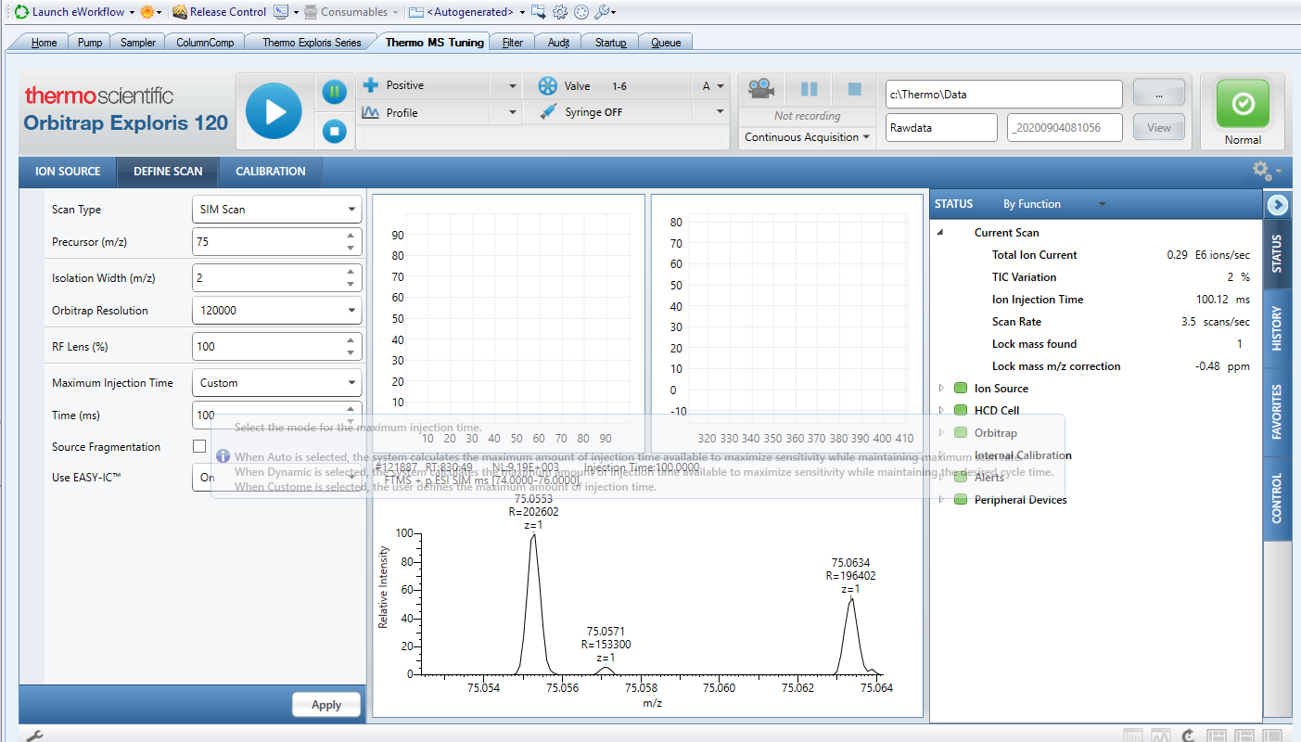
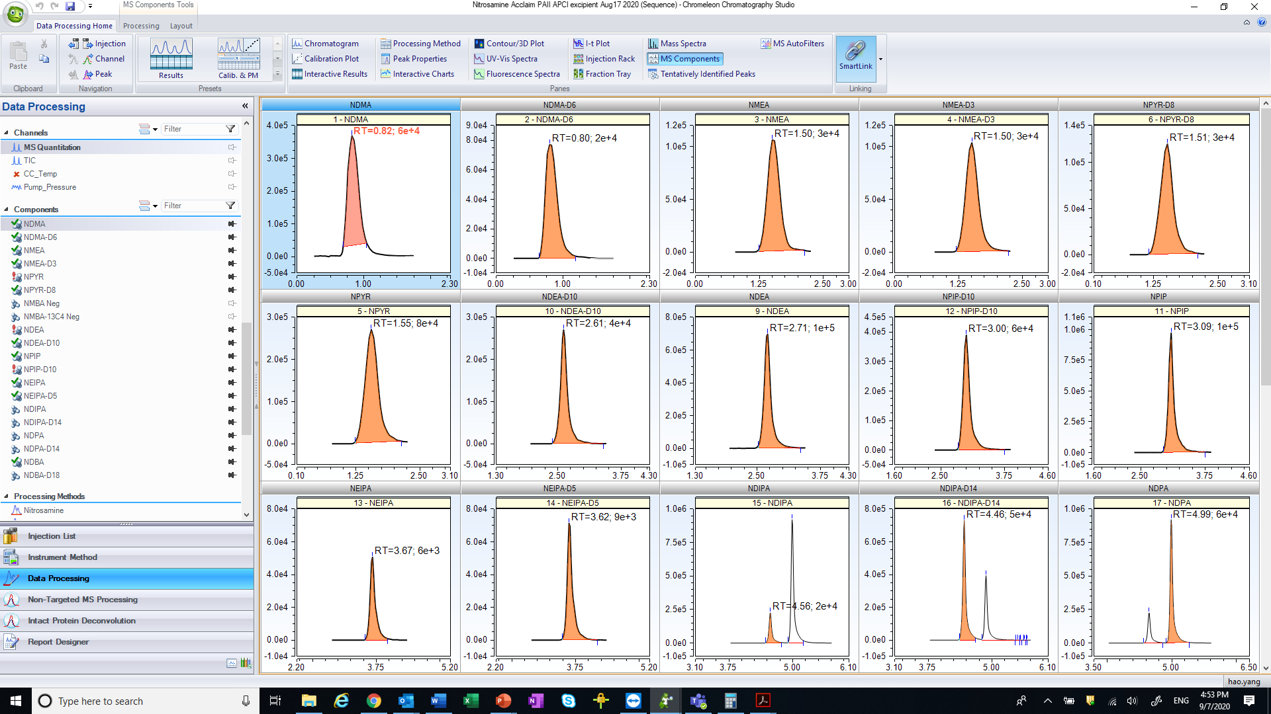
Application: Nitrosamine impurities analysis
Instrument control, data processing, and reporting all in single package
Chromeleon CDS 7.2.10
  Single platform for MS and chromatography
  Fully integrated with instrument control, data collection, processing and reporting
  21 CFR Part 11 compliant ready with full instrument and data audit trail

Slide 11
A complete Thermo Fisher Scientific solution
A robust and reproducible LC-HRMS method for detection and quantitation of 9 NAs in Ranitidine tablet
High resolution, minimum of 60K, is required to separate DMF isotope interferent peaks to avoid potential isobaric interferences
Adequate mass accuracy and tolerance setting is essential for reliable and accurate quantitation of NDMA in presence of co-eluting DMF in tablet extract
Achieved superior sensitivity with APCI, LLOQ ≤ 0.017 ppm for all NAs tested (FDA proposed limit is 0.03 ppm)
Demonstrated the use of Chromeleon 7.2.10 compliant ready CDS software for instrument control, data acquisition, processing, and reporting

Slide 12
Backup slides
Recovery and reproducibility of NAs from extraction process
LLOQ of NAs using HESI mode for both neat and excipient standards
LLOQ comparison between HESI vs APCI mode for target NAs

Slide 13
Application: Nitrosamine impurities analysis
Crush tablet and extract with methanol to give target concentration of 30mg/ml API
Mechanical shaker for 40 minutes
Centrifuge @ 4500 rpm for 15 minutes
Filter the supernatant with 0.22 µm PVDF filter
NAs recovery and reproducibility from the extraction process
 | 2ng/ml |  | 5ng/ml
 | % Recovery | % RSD | % Recovery | % RSD
NDMA | 99 | 8.4 | 97 | 7.2
NMEA | 93 | 9.0 | 97 | 4.5
NPYR | 101 | 3.6 | 99 | 5.3
NMBA | 94 | 13.3 | 94 | 8.8
NDEA | 95 | 3.0 | 97 | 3.4
NPIP | 97 | 1.6 | 96 | 3.8
NEIPA | 116 | 10.5 | 98 | 7.0
NDIPA | 95 | 3.1 | 100 | 2.9
NDPA | 105 | 2.2 | 104 | 1.8
NDBA | 101 | 2.8 | 100 | 4.9

Slide 14
Application: Nitrosamine impurities analysis
High sensitivity, LLOQ ≤ 0.068 ppm for target NAs for both neat and excipient standards, HESI mode
 | Matrix | LOD (ng/ml) | LLOQ (ng/ml) | PPM* | Linearity
NDMA | Neat | 0.2 | 0.5 | 0.017 | 0.5 – 50
 | Excipient | 0.5 | 0.5 | 0.017 | 0.5 – 50
NMEA | Neat | 0.5 | 0.5 | 0.017 | 0.5 – 50
 | Excipient | 0.5 | 0.5 | 0.017 | 0.5 – 50
NPYR | Neat | 0.1 | 0.1 | 0.0034 | 0.1 – 50
 | Excipient | 0.1 | 0.2 | 0.0068 | 0.2 – 50
NDEA | Neat | 0.2 | 0.5 | 0.017 | 0.5 – 50
 | Excipient | 0.5 | 0.5 | 0.017 | 0.5 – 50
NPIP | Neat | 0.2 | 0.2 | 0.0068 | 0.2 – 50
 | Excipient | 0.2 | 0.2 | 0.0068 | 0.2 – 50
NEIPA | Neat | 1 | 2 | 0.068 | 2 – 50
 | Excipient | 2 | 2 | 0.068 | 2 – 50
NDIPA | Neat | 0.2 | 0.5 | 0.017 | 0.5 – 50
 | Excipient | 0.2 | 0.5 | 0.017 | 0.5 – 50
NDPA | Neat | 0.2 | 0.2 | 0.0068 | 0.2 – 50
 | Excipient | 0.2 | 0.2 | 0.0068 | 0.2 – 50
NDBA | Neat | 0.1 | 0.5 | 0.017 | 0.5 – 50
 | Excipient | 0.1 | 0.5 | 0.017 | 0.5 – 50
Orbitrap Exploris 120 MS
  Max 120K resolution at m/z 200
  Sub ppm mass accuracy with EASY-IC ion source
  LLOQ ≤ 0.068 ppm for target NAs in HESI mode for both neat and excipient standards
We can achieve less than 0.017 ppm for all NAs except NEIPA in HESI mode
* PPM is calculated based on 30mg/ml of drug substance and product extract

Slide 15
Application: Nitrosamine impurities analysis
LLOQ comparison between HESI and APCI for all NAs (Neat only)
 | Mode | LOD (ng/ml) | LLOQ (ng/ml) | PPM* | Factor
NDMA | HESI | 0.2 | 0.5 | 0.017 | -
 | APCI | 0.2 | 0.2 | 0.0068 | 2.5x
NMEA | HESI | 0.5 | 0.5 | 0.017 | -
 | APCI | 0.2 | 0.2 | 0.0068 | 2.5x
NPYR | HESI | 0.1 | 0.1 | 0.0034 | -
 | APCI | 0.1 | 0.2 | 0.0068 | 1/2x
NDEA | HESI | 0.2 | 0.5 | 0.017 | -
 | APCI | 0.1 | 0.1 | 0.0034 | 5x
NPIP | HESI | 0.2 | 0.2 | 0.0068 | -
 | APCI | 0.1 | 0.1 | 0.0034 | 2x
NEIPA | HESI | 1 | 2 | 0.068 | -
 | APCI | 0.5 | 0.5 | 0.017 | 4x
NDIPA | HESI | 0.2 | 0.5 | 0.017 | -
 | APCI | 0.1 | 0.1 | 0.0034 | 5x
NDPA | HESI | 0.2 | 0.2 | 0.0068 | -
 | APCI | 0.1 | 0.1 | 0.0034 | 2x
NDBA | HESI | 0.1 | 0.5 | 0.017 | -
 | APCI | 0.1 | 0.5 | 0.017 | 1x
Orbitrap Exploris 120 MS
  Max 120K resolution at m/z 200
  Sub ppm mass accuracy with EASY-IC ion source
  Superior sensitivity can be achieved using both HESI and APCI mode
* PPM is calculated based on 30mg/ml of drug substance and product extract

